Slide 1
Chapter 6 Architectural Design

Slide 2
Lesson Objectives
Discuss why architectural design of software is important
Explain the 3 main activities in architectural design – overall system organization, modular decomposition and control modeling
Distinguish the models/styles involve in System Organization and Control Modeling

Slide 3
Architectural Design Activities
System Organization
Modular Decomposition
Control Modeling

Slide 4
Why Architectural Design is Important?

Slide 5



Introduction
Establish framework for:
Control & Communication
Systems
Identify sub-systems

Slide 6
Introduction
Systems
First stage in design process

Slide 7
Introduction
Large systems can be decomposed into sub-systems that provide some related set of services.
The initial design process of identifying these sub-systems and establishing a framework for sub-system control and communication is called architectural design.
Architectural design is the first stage in the design process and usually comes before detailed system specification.

Slide 8

Advantages of Explicit Architecture
1. Stakeholder communication
High-level presentation of system

Slide 9

Advantages of Explicit Architecture
2. System Analyst
Check whether the system can meet requirements

Slide 10

Advantages of Explicit Architecture
3. Large-scale reuse
Reusable architecture

Slide 11
Advantages of Explicit Architecture
Stakeholder communication
– used during discussion to show high-level presentation of system
System analysis
– check whether the system can meet critical requirements
Large-scale reuse
– The architecture may be reusable across a range of systems since it shows us how a system is organized and how the components interoperate.

Slide 12
Advantages of Explicit Architecture
4. Negotiation
Serve as design plan that can be used for negotiation & discussion

Slide 13

Advantages of Explicit Architecture
5. Complexity Management
Act as essential tool for complexity management

Slide 14
Advantages of Explicit Architecture
Other advantages:
Serve as design plan that can be used for negotiation and discussion
Act a essential tool for complexity management

Slide 15
Architectural Design Activities
System Organization
Modular Decomposition
Control Modeling

Slide 16
1. System Organization/Structuring

Slide 17
1. System Organization/Structuring
Represented in Block Diagram
Sub-systems

Slide 18
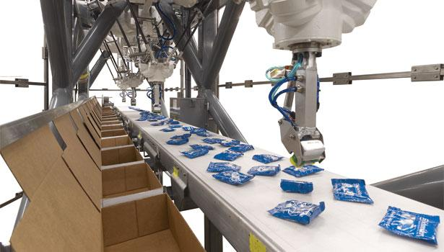
1. System Organization/Structuring
E.g. packing robot system

Slide 19
1. System Organization/Structuring
This is the first phase of the architectural design activity.
At its most abstract level, an architectural design may be depicted as a block diagram in which each box represents a sub-system, as shown in the following figure:- (next slide)

Slide 20
1. System Organization/Structuring
Vision system
Object Identification System
Arm Controller
Gripper Controller
Packing Selection System
Conveyer Controller
Packing System

Slide 21
1. System Organization/Structuring
Communication between sub-systems
Sub-systems 🡪
Independent Software Unit

Slide 22
1. System Organization/Structuring
Distribution
Interface with each other
How to share data

Slide 23
1. System Organization/Structuring
The system is structured into a number of principal sub-systems where a sub-system is an independent software unit.
Communications between sub-systems are also identified.
More specific models of the structure may be developed which show how sub-systems share data, how they are distributed and how they interface with each other.

Slide 24
1. System Organization/Structuring
3 widely used system organization styles/models are:
i) Repository model
ii) Client-server model
iii) Layered model

Slide 25
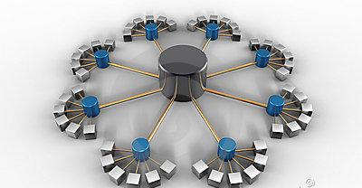
1. System Organization/Structuring
Repository Model
Central DB to share data

Slide 26
1. System Organization/Structuring
Repository Model – when to use?
Large amounts of data are to be shared

Slide 27
1. System Organization/Structuring
Repository Model -The architecture of an integrated CASE toolset
Program Editor
Report Generator
Code Generator
Design Analyzer
Project Repository
Design Editor
Design Translator

Slide 28
1. System Organization/Structuring
i) Repository Model
Sub-systems need to exchange data.
This may be done in two ways:
All shared data is held in a central database.
Each sub-system maintain its own database and interchange data by passing messages
When to use?
large amounts of data are to be shared, the repository model of sharing is most commonly used.

Slide 29
1. System Organization/Structuring
Repository Model - Advantages
Share large amount of data
Repository schema
Sub systems have no concern on how data is produced
Centralized management

Slide 30
1. System Organization/Structuring
i) Repository Model
Advantages
Efficient way to share large amounts of data;
Sub-systems need not be concerned with how data is produced
Centralised management e.g. backup, security, etc.
Sharing model is published as the repository schema.

Slide 31
1. System Organization/Structuring
Repository Model - Disadvantages
Sub systems must compromise on a data model
Difficult to distribute
Data evolution is difficult & expensive
No scope for specific management policies

Slide 32
1. System Organization/Structuring
i) Repository Model
Disadvantages
Sub-systems must agree on a repository data model. Inevitably a compromise;
Data evolution is difficult and expensive;
No scope for specific management policies;
Difficult to distribute efficiently

Slide 33


1. System Organization/Structuring
ii) Client-Server Model
Distributed system model
Client-Server Model
Data & processing in different components

Slide 34
1. System Organization/Structuring
ii) Client-Server Model
A set of stand-alone servers which provide specific services such as printing, data management, etc
Client-Server Model

Slide 35
1. System Organization/Structuring
ii) Client-Server Model
Set of clients which call on these services
Client-Server Model

Slide 36
1. System Organization/Structuring
ii) Client-Server Model
Network which allows clients to access servers
Client-Server Model

Slide 37
1. System Organization/Structuring
ii) Client-Server Model
Distributed system model which shows how data and processing is distributed across a range of components.
Set of stand-alone servers which provide specific services such as printing, data management, etc.
Set of clients which call on these services.
Network which allows clients to access servers.

Slide 38
1. System Organization/Structuring
ii) Client-Server Model - The architecture of a film and picture library system
Client 1
Client 2
Client 3
Client 4
Wide-bandwidth network
Catalogue Server
Video Server
Picture Server
Hypertext Server
Catalogue
Film Clip Files
Digitized Photographs
Hypertext Web

Slide 39
1. System Organization/Structuring
ii) Client-Server Model
Distribution of data is straightforward
Effective network system
Cheaper hardware
Advantages
Easy to add or upgrade server

Slide 40
1. System Organization/Structuring
ii) Client-Server Model
Different data model 🡪 inefficient data sharing
Disadvantages
Redundant mgmt
No central register of names & services

Slide 41
1. System Organization/Structuring
ii) Client-Server Model
Advantages
Distribution of data is straightforward;
Makes effective use of networked systems. May require cheaper hardware;
Easy to add new servers or upgrade existing servers.
Disadvantages
No shared data model so sub-systems use different data organisation. Data interchange may be inefficient;
Redundant management in each server;
No central register of names and services - it may be hard to find out what servers and services are available.

Slide 42

1. System Organization/Structuring
iii) Layered Model
A.k.a Abstract Machine Model
Model interfacing of sub-system
Layered Model
Layers with services

Slide 43
1. System Organization/Structuring
iii) Layered Model
Support incremental development
Closed layered model 🡪 one layer change, only adjacent layer is affected
Layered Model

Slide 44
1. System Organization/Structuring
iii) Layered Model
Also called abstract machine model
Used to model the interfacing of sub-systems.
Organises the system into a set of layers each of which provide a set of services
Supports the incremental development of sub-systems in different layers. When a layer interface changes, only the adjacent layer is affected

Slide 45
1. System Organization/Structuring
iii) Layered Model – Version Management System
Configuration management system layer
Object management system layer
Database system layer
Operating system layer

Slide 46

2. Modular Decomposition

Slide 47
2. Modular Decomposition
Decomposition of sub-systems into modules
Components in modules

Slide 48
2. Modular Decomposition
After an overall system organization has been chosen, you need to make a decision on the approaches to be used to decompose sub-systems into modules.
This is the decomposition of sub-systems into modules. The components in modules are usually smaller than sub-systems and this allows alternative decomposition models to be used.

Slide 49
2. Modular Decomposition
Object-Oriented Decomposition
Function-Oriented Decomposition
Strategies

Slide 50
2. Modular Decomposition
2 main strategies on decomposing a sub-system into modules:
i) Object-oriented decomposition
– an object model where decompose a system into a set of communicating objects
ii) Function-oriented decomposition
– an pipeline/ data-flow model where decompose a system into functional modules that accept input data and transform them into output data.

Slide 51
2. Modular Decomposition
Object-Oriented Decomposition – Invoice Processing System
Client
Receipt
CustomerNo
Name
Address
CreditPeriod
InvoiceNo
Date
Amount
CustomerNo
Invoice
InvoiceNo
Date
Amount
Customer
Payment
Issue()
sendReminder()
acceptPayment()
sendReceipt()
InvoiceNo
Date
Amount
CustomerNo

Slide 52
2. Modular Decomposition
Function-Oriented Decomposition – Invoice Processing System
Issue receipts
Receipts
Read issued invoices
Identify payments
Find payments due
Issue payment reminder
Invoices
Payments
Reminders

Slide 53


Slide 54
Trick Question
How many O's are in this number: one thousand seven hundred and one
2
1
3
207

Slide 55
Trick Question
How many O's are in this number: one thousand seven hundred and one
2
1 🡪 1701
3
207

Slide 56
1. System Organization/Structuring
i) Repository model
ii) Client-server model
iii) Layered model
2. Modular Decomposition
i) Object-oriented Decomposition
ii) Functional-oriented Decomposition
3. Control Modeling
i) Centralized Control
a. Call-Return Model
b. Manager Model
ii) Event-based Control
a. Broadcast Model
b. Interrupt-driven Model

Slide 57
3. Control Modeling

Slide 58


3. Control Modeling
Sub-systems need to be controlled
Services are delivered to the right place at the right time

Slide 59
3. Control Modeling
The models for structuring a system are concerned with how a system is decomposed into sub-systems. However, to work as a system, sub-systems must be controlled so that their services are delivered to the right place at the right time.
Structural/ Organizational models do not include control information.
Hence, a general model of the control relationships between the parts of the system is established
Concerned with the control flow between sub-systems

Slide 60
3. Control Modeling
Concerned with the control flow between sub-systems
General model of the control relationships between sub-systems

Slide 61
3. Control Modeling
i) Centralized control
Call-return model
Manager model
2 general control styles
ii) Event-based control
Broadcast model
Interrupt-driven model

Slide 62

3. Control Modeling
i) Centralized Control
One sub-system has overall responsibility for control and starts and stops other sub-systems.

Slide 63
3. Control Modeling
i) Centralized Control – Call-Return Model
Top-down subroutine model
Sequential systems

Slide 64
3. Control Modeling
i) Centralized Control – Call-Return Model
Main Program
Routine 1
Routine 2
Routine 3
Routine 1.1
Routine 1.2
Routine 3.1
Routine 3.2
🡪top down sub-routine model
🡪applicable for sequential systems

Slide 65

3. Control Modeling
i) Centralized Control – Manager Model
One system manager
Concurrent systems
Sequential systems 🡪 case statement

Slide 66
3. Control Modeling
Centralized Control – Manager Model
One system component is designated as system manager i.e. controls the stopping, starting and coordination of other system processes.
Applicable to concurrent systems.
Can be implemented in sequential systems as a case statement.

Slide 67
3. Control Modeling
i) Centralized Control – Manager Model
Sensor Processes
Computation processes
Actuator processes
System Controller
User interface
Fault handler
🡪 a system component is designated as system manager
🡪 processes(sub-systems) can execute concurrently
🡪 applicable for concurrent systems

Slide 68

3. Control Modeling
ii) Event-based Control
Response to event from other system or environment

Slide 69
3. Control Modeling
ii) Event-based Control
each sub-system can respond to externally generated events that might come from other sub-systems or environment.

Slide 70

3. Control Modeling
ii) Event-based Control – 1. Broadcast Model
Event is broadcasted
Whoever can handle will respond

Slide 71
3. Control Modeling
ii) Event-based Control – 1. Broadcast Model
An event is broadcast to all sub-systems. Any sub-system which can handle the event may respond to it.
Effective in integrating sub-systems distributed across different computers on a network

Slide 72
3. Control Modeling
ii) Event-based Control – 1. Broadcast Model
Subsystem 1
Subsystem 2
Subsystem 3
Subsystem 4
Event and Message Handler
Event | Subsystem
E1 | SS1
E2 | SS2
E3 | SS3
E4 | SS4
🡪 an event is broadcast to all sub-systems
🡪 effective in integrating sub-systems distributed across different computers on a network

Slide 73
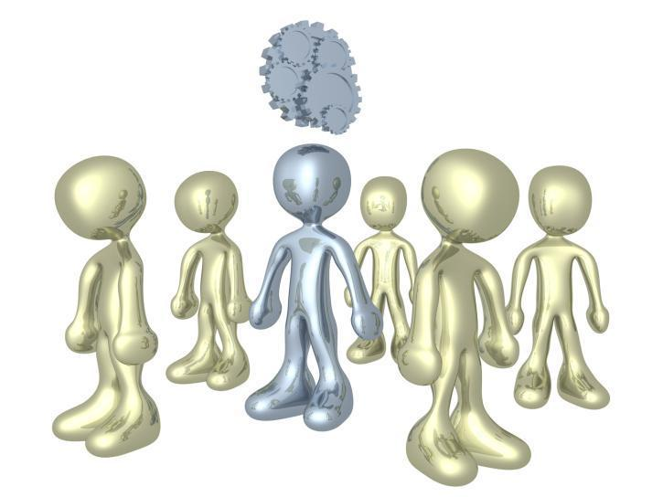
3. Control Modeling
ii) Event-based Control – 2. Interrupt-Driven Model
Interrupt Handler
Real Time System

Slide 74
3. Control Modeling
ii) Event-based Control –
2. Interrupt-Driven Model
Used in real-time systems where interrupts are detected by an interrupt handler and passed to some other component for processing.

Slide 75
Revision
System organization
Structure the system into main sub-systems & identify their communication. What are the Models?
Modular Decomposition
Decompose sub-systems into modules. What are the models?
Control Modeling
Establish control relationship between sub-systems/ modules. What are the Models?

Slide 76
1. System Organization/Structuring
i) Repository model
ii) Client-server model
iii) Layered model
2. Modular Decomposition
i) Object-oriented Decomposition
ii) Functional-oriented Decomposition
3. Control Modeling
i) Centralized Control
a. Call-Return Model
b. Manager Model
ii) Event-based Control
a. Broadcast Model
b. Interrupt-driven Model

Slide 77
Pop Quiz
What is the difference between Validity and Completeness?

